Slide 1
CALL_VOLUME TREND ANALYSIS

Slide 2
Approach
Link to Analysis Excel file - here
• Understanding the data • Getting familiar with the data values and attributes • Analysing the data by applying filters and formulas • Visualise the data with graph/ charts to get better understanding
Steps
1. Clean the data by checking missing/null values.
2. Check for outliers in different columns.
3. Find Correlation between columns.
TECH STACK Used
Microsoft Excel

Slide 3
PROBLEM STATEMENT
For my final project, I am provided with a dataset of a Customer Experience (CX) Inbound calling team for 23 days.
Data includes Agent_Name, Agent_ID, Queue_Time [duration for which customer have to wait before they get connected to an agent], Time [time at which call was made by customer in a day], Time_Bucket [for easiness we have also provided you with the time bucket], Duration [duration for which a customer and executives are on call, Call_Seconds [for simplicity we have also converted those time into seconds], call status (Abandon, answered, transferred).
Company wants to understand information related to avg call time duration, no. of calls received/answered/abandoned/transferred and requirement of agents.

Slide 4
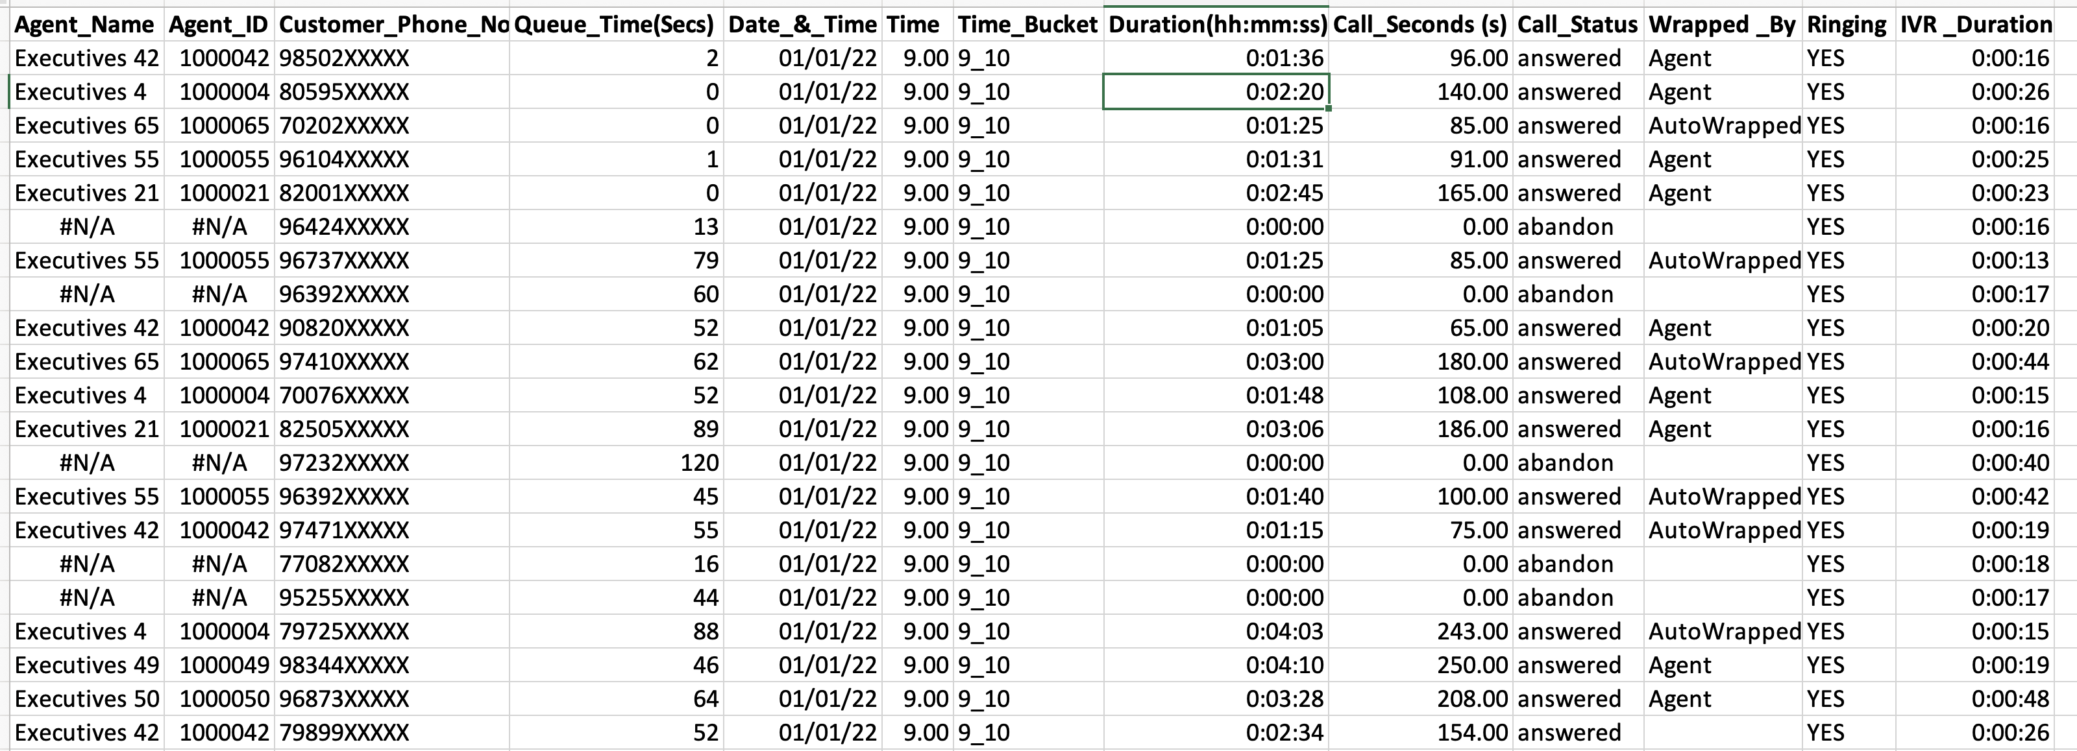
Dataset
Dataset has 117988 rows and 13 columns

Slide 5
Avg call time/duration
Overall Avg Call Duration = 197 s
Time_Bucket | Average Call_Seconds (s)
9_10 | 198.7
10_11 | 202.6
11_12 | 198.7
12_13 | 191.2
13_14 | 193.3
14_15 | 192.0
15_16 | 195.9
16_17 | 198.3
17_18 | 197.9
18_19 | 200.1
19_20 | 202.5
20_21 | 202.5
Call duration is more in morning and evening time, less in afternoon time. Maximum call duration is 202.6 s whereas least is 191.2 s.

Slide 6
No. of calls in 23 days
Time_Bucket | count_calls | Answered | Abandon | Transfer
9_10 | 9588 | 4428 | 5149 | 11
10_11 | 13313 | 6368 | 6911 | 34
11_12 | 14626 | 8560 | 6028 | 38
12_13 | 12652 | 9432 | 3073 | 147
13_14 | 11561 | 8829 | 2617 | 115
14_15 | 10561 | 7974 | 2475 | 112
15_16 | 9159 | 7760 | 1214 | 185
16_17 | 8788 | 7852 | 747 | 189
17_18 | 8534 | 7601 | 783 | 150
18_19 | 7238 | 6200 | 933 | 105
19_20 | 6463 | 4578 | 1848 | 37
20_21 | 5505 | 2870 | 2625 | 10
Total | 117988 | 82452 | 34403 | 1133
% |  | 70% | 29% | 1%
Total calls in 23 days = 117988

Slide 7
Avg No. of calls per day
Avg no. of calls per day = 5130
Time_Bucket | count_calls
9_10 | 417
10_11 | 579
11_12 | 636
12_13 | 550
13_14 | 503
14_15 | 459
15_16 | 398
16_17 | 382
17_18 | 371
18_19 | 315
19_20 | 281
20_21 | 239

Slide 8
Manpower to answer 90% calls
For each day
Time_Bucket | count_calls | 90% calls | Avg Call_time (s) | Call Time (Hrs) | man required
9_10 | 417 | 375.2 | 198.7 | 20.7 | 5
10_11 | 579 | 520.9 | 202.6 | 29.3 | 7
11_12 | 636 | 572.3 | 198.7 | 31.6 | 7
12_13 | 550 | 495.1 | 191.2 | 26.3 | 6
13_14 | 503 | 452.4 | 193.3 | 24.3 | 5
14_15 | 459 | 413.3 | 192.0 | 22.0 | 5
15_16 | 398 | 358.4 | 195.9 | 19.5 | 4
16_17 | 382 | 343.9 | 198.3 | 18.9 | 4
17_18 | 371 | 333.9 | 197.9 | 18.4 | 4
18_19 | 315 | 283.2 | 200.1 | 15.7 | 3
19_20 | 281 | 252.9 | 202.5 | 14.2 | 3
20_21 | 239 | 215.4 | 202.5 | 12.1 | 3
 |  |  |  | Total men | 56
Assumption: Every agent attend calls for 4.5 hours in a day

Slide 9
Manpower in night shift
Time | 9pm - 10 pm | 10pm-11 pm | 11pm - 12am | 12am-1am | 1am-2am | 2am-3am | 3am-4am | 4am-5am | 5am-6am | 6am-7am | 7am-8am | 8am-9am
% calls | 3 | 3 | 2 | 2 | 1 | 1 | 1 | 1 | 3 | 4 | 4 | 5
No. of calls | 154 | 154 | 103 | 103 | 51 | 51 | 51 | 51 | 154 | 205 | 205 | 256
90% calls | 139 | 139 | 92 | 92 | 46 | 46 | 46 | 46 | 139 | 185 | 185 | 231
Call time(hrs) | 7.58 | 7.58 | 5.05 | 5.05 | 2.53 | 2.53 | 2.53 | 2.53 | 7.58 | 10.11 | 10.11 | 12.63
Agents | 2 | 2 | 1 | 1 | 1 | 1 | 1 | 1 | 2 | 2 | 2 | 3
Time | Agents
9pm - 10 pm | 2
10pm-11 pm | 2
11pm - 12am | 1
12am-1am | 1
1am-2am | 1
2am-3am | 1
3am-4am | 1
4am-5am | 1
5am-6am | 2
6am-7am | 2
7am-8am | 2
8am-9am | 3
Total | 19
Assumption: Every agent attend calls for 4.5 hours in a day

Slide 10
results
Average call time is 197s. Call duration is more in morning and evening time, less in afternoon time.
Avg no. of calls per day = 5130, max calls received between 10 am to 3 pm
Currently 70% calls are answered, 29% are abandoned and 1% calls are transferred.
To increase answered calls to 90%, 56 agents will be required in a day time from 9am – 9pm.
In the night-time from 9pm to 9am, 19 agents will be needed to attend 90% of calls.

